Slide 1
Welcome. We will start promptly at noon
Our audio is currently muted
Call in number if your computer audio is not working:
+1 669 900 6833 US
Meeting ID: 575 366 462
Please do NOT add your name and affiliation to the chat box when you log on.
For educational and quality improvement purposes, these sessions are being recorded.

Slide 2
Welcome. We will start promptly at noon
Reminder: You must complete the post-session survey that will be sent to you at 1:30 p.m. today to receive Continuing Medical Education (CME) credit for attending this session.
Chat box questions will be collected and addressed as soon as possible, either during or post-session; Questions/comments will be used to develop future session agendas.
Slides, video recordings of these sessions and other materials are available on the ECHO Connect site where you registered

Slide 3
Special
Oregon COVID-19 Response for Clinicians

Slide 4

oregonechonetwork.org

Slide 5
Special COVID-19 ECHO Series Goals
Provide the latest information on the COVID-19 pandemic and it’s impact on Oregon
Deliver brief didactic sessions on key areas, e.g., clinical management, hospital/critical care management, prevention, practice system & workflow, community impact, ethical issues, older adult & vulnerable populations, long term care management, etc.
Provide a forum to share clinical, community, and system cases to improve quality and inform ‘best practice’

Slide 6
Overview
COVID-19 Update
Projected COVID-19 Epidemic Trends
Testing
General COVID-19 Questions
Clinical Care Guidance/Triage
Telehealth Coverage
Personal Protective Equipment
Healthcare Workforce

Slide 7
The COVID-19 Pandemic Update in Oregon
As of April 1st:
826 positive COVID-19 cases
21 deaths
16,082 negative tests
Community transmission is broad and test results do not reflect the full impact of COVID-19 in our state.

Slide 8
Projected COVID-19 Epidemic Trends

Slide 9
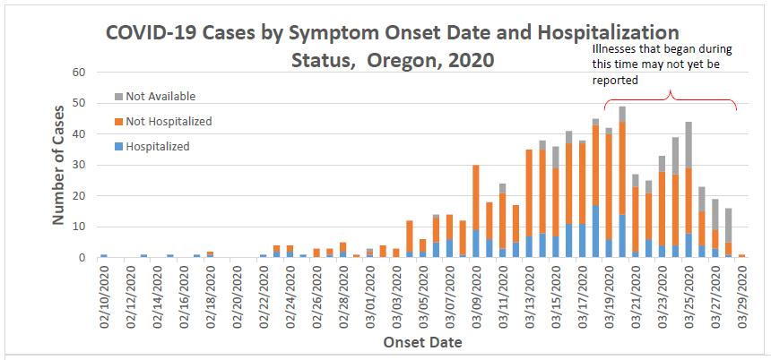
Last Updated: 04/01/2020 0900
Notes:
Make sure to adjust the timeline for cases not being reported after updating the epi curve. We picked 10 days – consistent with CDC.

Slide 10
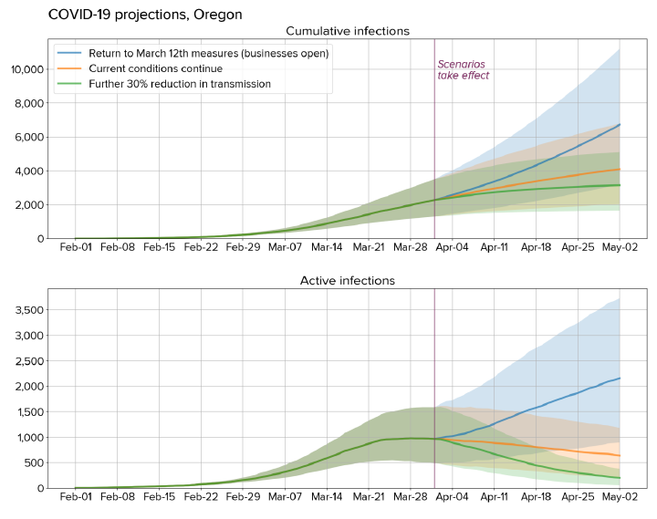
Notes:
OHA has partnered with the Institute for Disease Modeling to get estimates of COVID-19 cases in Oregon now and going forward
New modeling results calibrated to the latest available Oregon data (up to March 27th) suggest slightly higher numbers of current infections in Oregon than previously estimated, due to an increase in the number of diagnosed cases reported at earlier time points.
However, there is also strong evidence that measures currently in place in Oregon are reducing transmission. Due to the delay between infection and diagnosis, there is considerable uncertainty in the impact of the most recent intervention, the March 23rd “stay-at-home” order.
However, the data are consistent with current transmission rates having been reduced by 50-70% compared to baseline.

Slide 11
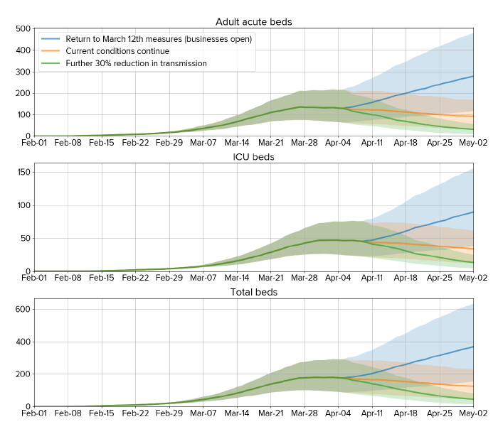
Projected Number of Hospital Beds for COVID-19 Patients in Oregon
Notes:
If Oregonians can maintain current social distancing efforts and the current projections hold true, the state could meet the likely demand for hospital beds under current strategies.
Researchers found expected demand for hospital beds is predicted to remain relatively constant before decreasing, assuming current or strengthened interventions and continued high compliance
We stress the need for a continuation of strong social distancing measures to stop the spread of COVID-19. Furthermore, additional measures, including increased testing, early isolation of positives, and contact tracing, will be required to rapidly bring down the number of active infections.

Slide 12
COVID-19 Testing

Slide 13
COVID-19 Testing Updates
Suggested groups for COVID-19 testing at clinical laboratories: persons with fever, cough, or dyspnea:
Healthcare workers and first responders
Patients with worsening symptoms
Patients older than 60 years of age
Patients with underlying medical conditions, including hypertension, diabetes, cardiovascular disease, lung disease, and immunocompromising conditions
Pregnant women
Patients who had contact with a suspect or lab-confirmed COVID-19 patient, or who had travel from an affected geographic area, within 14 days of their symptom onset

Slide 14
COVID-19 Testing Updates, Q&A
Oregon State Public Health Lab testing:
Hospitalized patients with viral lower respiratory infection (and flu testing ordered while flu is circulating)
Symptomatic persons (fever, cough, or dyspnea) in a facility or group setting (e.g., healthcare facility, residential care facility, school, or corrections)

Slide 15
Clinical Care/Triage

Slide 16
Recent Changes to Clinical Care and Healthcare Infection Prevention Guidance (March 27)
Discontinuation of Transmission-based Precautions for Hospitalized Patients: Provides criteria for discontinuation of transmission-based precautions, prioritizing a test-based strategy for patients that require continued hospitalization or will be transferred to a long-term care setting
Work Exclusion and Monitoring Determinations: Recommendations include allowances for asymptomatic healthcare workers who have had an exposure to a COVID-19 patient to continue to work with strict self-monitoring for symptoms
Return-to-work considerations for healthcare personnel: Simplifies recommendation for return-to-work timeline to a minimum of 72 hours post-resolution of fever and cough. Provides return-to-work best practices and considerations for crisis care scenarios.

Slide 17
Telehealth

Slide 18
OHA/DCBS Telehealth Guidance
Health plans shall cover telehealth services delivered by in-network providers to replace in-person visits whenever possible and medically or clinically appropriate.
Health plans shall examine reimbursement rates for telehealth services to ensure they are adequate to enable providers to increase capacity to serve patients with appropriate telehealth delivery methods.
Health plans shall ensure cost-sharing requirements for services delivered via telehealth are no greater than if the service was delivered through in-person settings.
Health plans shall clearly communicate (e.g. prominently posting information on website) to their members and provider networks about options to receive health care services via appropriate telehealth delivery modes as well as how to bill for such services.
The full guidance can be found here: https://dfr.oregon.gov/insure/health/understand/Documents/DFR-OHA%20Telehealth%20Guidance.pdf

Slide 19
Telehealth Coverage for the Oregon Health Plan (OHP)
Prioritized List of Health Services, Effective 3/13/2020
Guideline Note A5 TELECONSULTATIONS AND ELECTRONIC/TELEPHONIC SERVICES
Statement of Intent 6 TELEPHONIC SERVICES DURING AN OUTBREAK OR EPIDEMIC

Slide 20
OHP Coverage of Telehealth/phone Visits
Type of service | Description | Codes (CPT, HCPCS, modifiers) | Use
Telehealth – synchronous video and audio | Visit with provider in which patient and provider interact by audio and video in real time, ideally through a HIPAA-compliant system. Services like Skype, Hangouts and FaceTime are acceptable during the epidemic.¹ | Extensive list of codes including usual office visit and behavioral health codes, inpatient/ICU. If the patient is in a clinical site (e.g. clinic, ICU), that site can bill Q3014. | Inpatient Outpatient New patients Established patients
E-visits | Asynchronous electronic visits, such as through EPIC MyChart or other patient portals. | 99421-99423 G2061-G2063 98970-98972 (Depending on provider type) | Codes indicate established patients only² Patient initiated³
²
¹See HHS notice of enforcement discretion. Some payers are/will allow these services to be billed by telephone.
²OHP FFS will not audit for compliance with established patient requirements for telephone/online services. CCOs have been asked to allow telephone services for new patients
³Providers may make patients aware of the service, but the patient must request the service
and be notified of any cost sharing (no cost sharing for OHP).

Slide 21
OHP Coverage of Telehealth/phone visits
Type of service | Description | Codes (CPT, HCPCS, modifiers) | Use
Telephone only visits | Telephonic visit, physician and nonphysician codes | 98966-98968 (nonphysician) 99441-99443 (physician) | Codes indicate established patients only²
Quick virtual check in By phone or audio/video connection | 5-10 minutes | G2012 | Codes indicate established patients only²
Clinician to Clinician | Interprofessional consultation | 99451-99452 99446-99449 | Inpatient, outpatient, emergency. New or established.
²OHP FFS will not audit for compliance with established patient requirements for telephone/online services. CCOs have been asked to allow telephone services for new patients
³Providers may make patients aware of the service, but the patient must request the service and be notified of any cost sharing (no cost sharing for OHP).

Slide 22
OHP Coverage of Telehealth/phone visits
Type of service | Description | Codes (CPT, HCPCS, modifiers) | Use
Preventive medicine | Preventive medicine visits (when appropriate and possible without physical exam) | 99381-99395 | Preventive medicine (immunizations can be billed separately and delivered drive-through)

Slide 23
Payment Parity (OHP)
OHA is directing CCOs under a temporary rule filing on Telemedicine Payment Parity Requirements to reimburse contracted physical and behavioral health providers for covered services provided to OHP members by means of telemedicine (including phone), as at the same rate paid when such services are provided in person.
OHA has not directed CCOs in rule or contract to reimburse their contracted physical and behavioral health providers at the Fee-For-Service rate.
CCOs and MCEs will continue to reimburse non-contracted providers for telemedicine services at the rates agreed to between the MCE and the provider or at the OHP Fee-For-Service rates, whichever is greater.
Telemedicine services must be delivered consistent with all relevant OARs including requirements relating to language access, interpreter, and translation services.
OHP is paying for services delivered by telemedicine at facility rates and seeking authority to raise the rates for the telephone codes.

Slide 24
Resources for Telehealth: billing and state/federal policy
Situation is evolving; billing guidance may vary by plan/payer. For OHP FFS the team are still working on detailed guidance. For the latest…
OHP Partners COVID-19 page: https://www.oregon.gov/OHA/HSD/OHP/Pages/COVID-19.aspx
  Includes guidance on teledentistry, FQHC, PA requests, presumptive eligibility and behavioral health
  Will be updated as new information becomes available.
HHS HIPAA enforcement discretion page for providers: https://www.hhs.gov/hipaa/for-professionals/special-topics/emergency-preparedness/notification-enforcement-discretion-telehealth/index.html
Division of Financial Regulation (State-regulated insurance): https://dfr.oregon.gov/insure/health/understand/Pages/coronavirus.aspx
Medicare fact sheet: https://www.cms.gov/newsroom/fact-sheets/medicare-telemedicine-health-care-provider-fact-sheet

Slide 25
Personal Protective Equipment

Slide 26
Recent Changes to Clinical Care and Healthcare Infection Prevention Guidance (March 27)
Extended Use of Personal Protective Equipment: Recommends extended use of masks and face shield for cohorted care of patients with COVID-19

Slide 27
Aerosol-generating procedures (limited list)
Intubation, extubation and related procedures such as manual ventilation and open suctioning
Cardiopulmonary resuscitation (CPR)
Tracheotomy/tracheostomy procedures (insertion/open suctioning/removal)
Bronchoscopy
Surgery and post-mortem procedures involving high-speed devices
Some dental procedures (such as high-speed drilling)
Non-invasive ventilation (NIV) such as bi-level positive airway pressure (BiPAP) and continuous positive airway pressure ventilation (CPAP)
High-frequency oscillating ventilation (HFOV)
High-flow nasal oxygen (HFNO), also called high-flow nasal cannula
Induction of sputum
Medication administration via continuous nebulizer
*Note: this list is not exhaustive. Please discuss activities not described with your Infection Control Department.

Slide 28
PPE Donations
Guidance for submitting donated materials can be found at:
https://oregonrecovers.communityos.org/

Slide 29
Healthcare Workforce
Statewide Emergency Registry of Volunteers in Oregon (SERV-OR):
Are you a licensed healthcare professional in Oregon? Health care workers can #volunteer for emergency responses and help to fight #COVID19 in Oregon by registering with SERV-OR.
https://serv-or.org/
Oregon Medical Board updated information on COVID-19:
https://www.oregon.gov/omb/Topics-of-Interest/Pages/COVID-19.aspx

Slide 30
RESOURCE LINKS:
Oregon Health Authority:
www.healthoregon.org/coronavirus (all information)
www.healthoregon.org/coronavirushcp (healthcare provider)
CDC COVID-19 site:
https://www.cdc.gov/coronavirus/2019-ncov/index.html
Oregon ECHO Network :
www.oregonechonetwork.org
CASE/Community Innovation presentations:
Email Miriam Wolf wolfmi@ohsu.edu

Slide 31
“All Teach, All Learn”
Clinicians learn from specialists
Clinicians learn from each other
Specialists learn from practicing clinicians

