Slide 1
Special
Oregon COVID-19 Response for Clinicians
Session 9 May 14, 2020

Slide 2
Sign up !
“COVID-19 Response ECHO for Oregon Clinicians Part II”
Registration is open for Cohort 2 of the COVID-19 ECHO
2nd and 4th Thursday of each month, noon – 1 p.m.
Begins June 11 and continues through September 24, 2020
You must register to receive CME for these sessions
COVID-19 ECHO Part II Objectives:
  Provide latest information on COVID19 impact on Oregon;
  Receive guidance on evidence-based management of COVID-19;
  A forum to share clinical, community, and system cases to improve quality and inform ‘best practice’
Sign up at www.oregonechonetwork.org

Slide 3

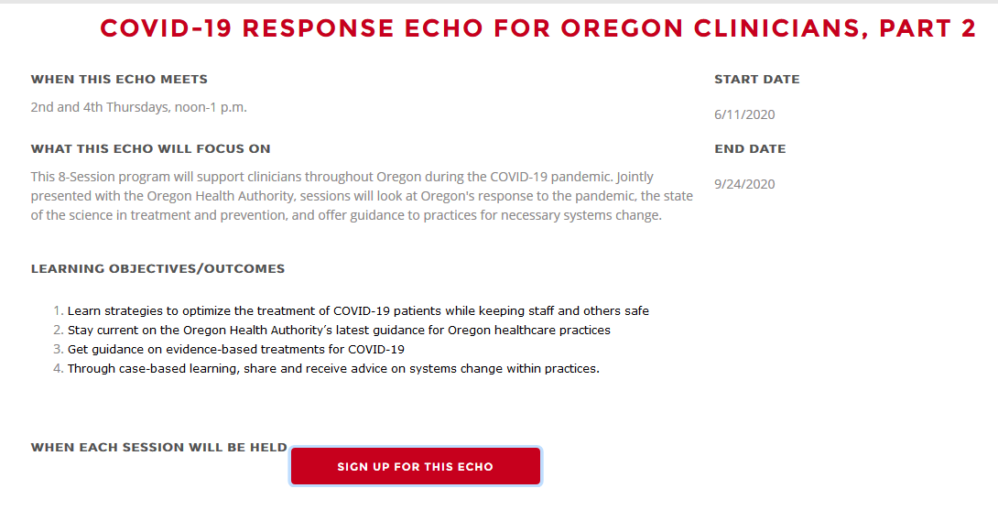
1. Go to www.oregonechonetwork.org
And click on the sign-up link.
2. You’ll need to log in to your Connect account and click the button to sign up for the ECHO

Slide 4
Special COVID-19 ECHO Series Goals
Provide the latest information on the COVID-19 pandemic and it’s impact on Oregon
Deliver brief didactic sessions on key areas, e.g., clinical management, hospital/critical care management, prevention, practice system & workflow, community impact, ethical issues, older adult & vulnerable populations, long term care management, etc.
Provide a forum to share clinical, community, and system cases to improve quality and inform ‘best practice’

Slide 5
Today’s Agenda
COVID-19 Update
Expert presentation: “Testing and Transmission of COVID-19”, Mark Slifka PhD, OHSU
Community presentation: Lara Knudsen MD, Alluvium Mobile Health Team
Q & A

Slide 6

Oregon Health Authority
COVID-19 Update, May 14, 2020
Dana Hargunani, MD MPH
Tom Jeanne, MD, MPH

Slide 7
Agenda Items
COVID-19 epi and hospitalization data
Re-opening Oregon
Immunizations during COVID-19
Asymptomatic COVID-19 transmission
Pediatric multisystem inflammatory syndrome
General COVID-19 Questions
Closing

Slide 8
Epidemiology Update

Slide 9
The COVID-19 Pandemic Update in Oregon
As of May 13th:
3,338 positive COVID-19 tests
134 deaths
83,909 negative tests
Test results do not reflect the full impact of COVID-19 in our state
Notes:
Represents an increase from the prior day:
55 new confirmed cases
4 new presumptive cases
4 new deaths
Ongoing outbreaks: LTCFs, food processing plants, corrections

Slide 10
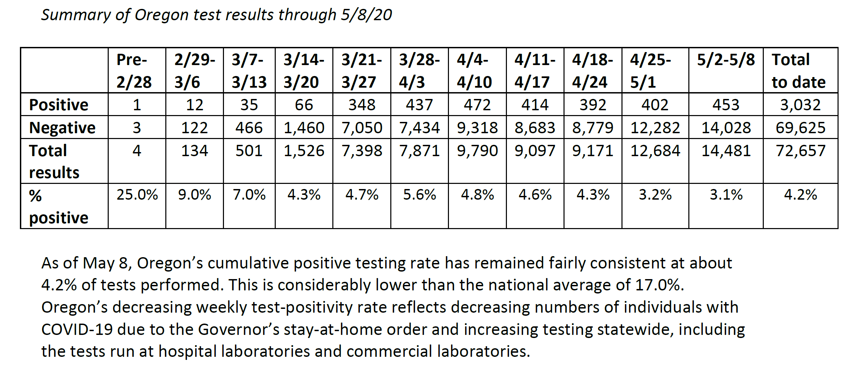
Testing Results Summary through 5/8

Slide 11
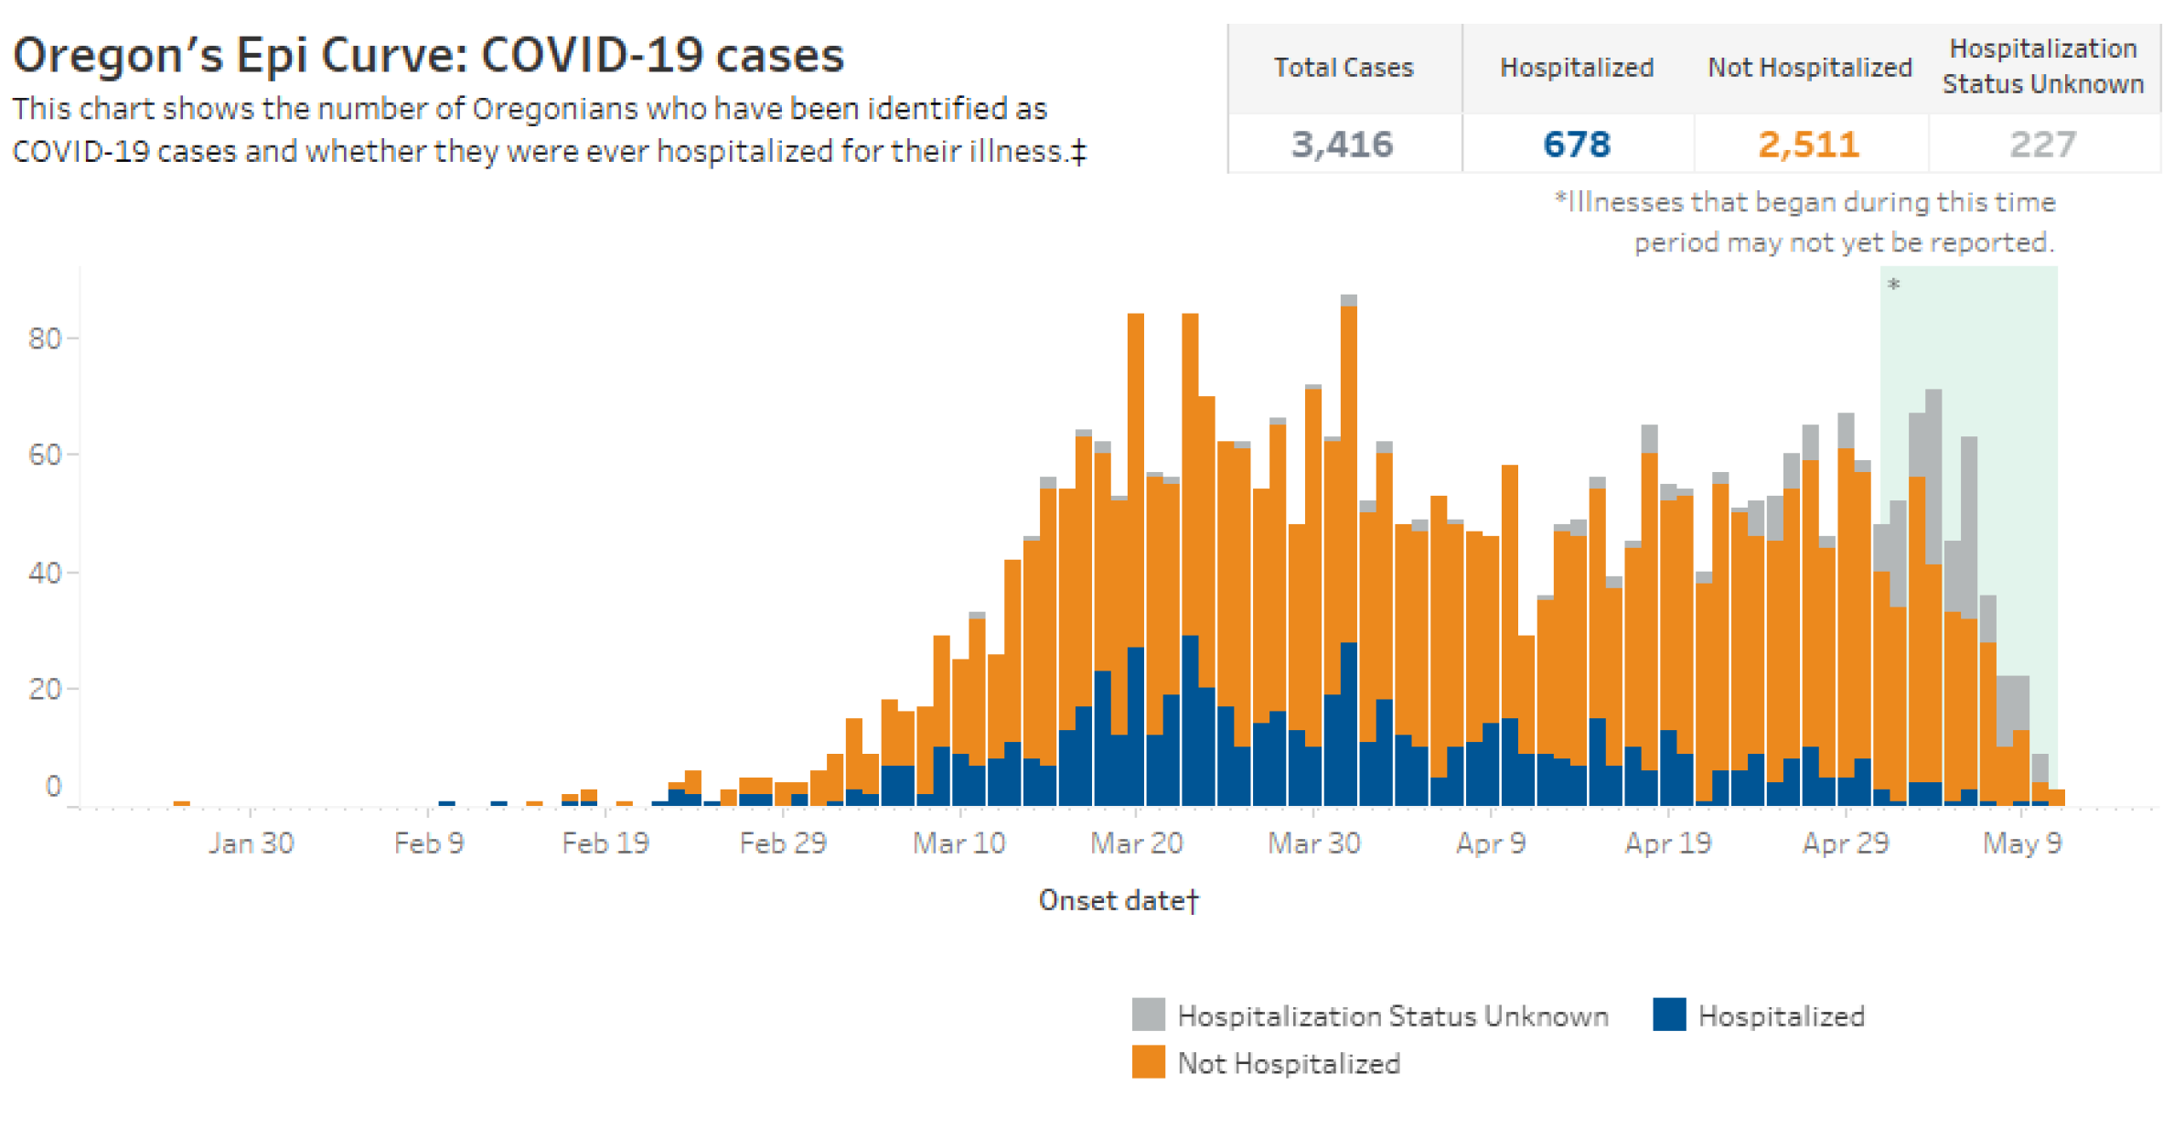
Epidemiologic curve

Slide 12
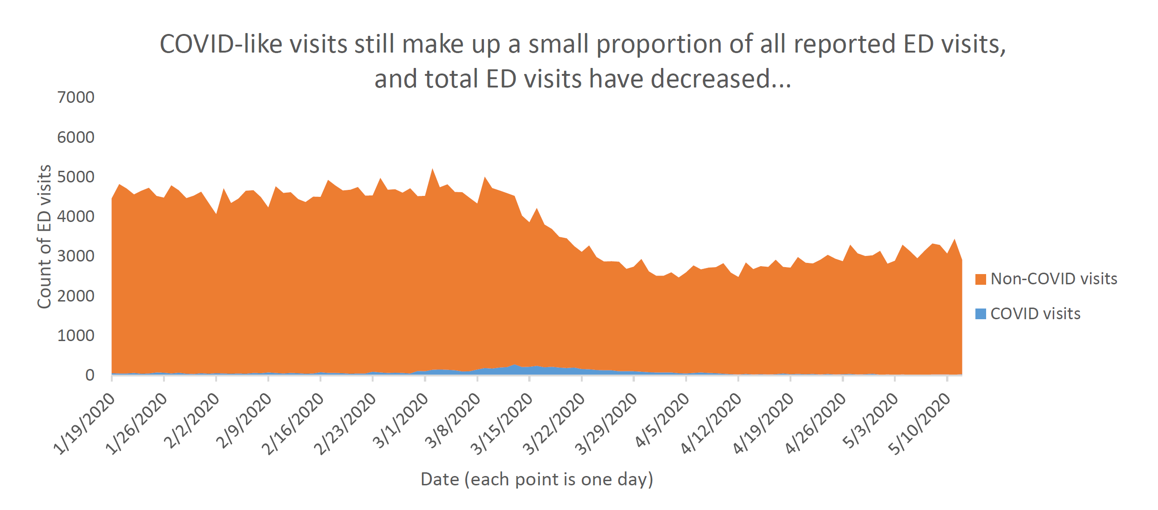
Daily ED visits
Notes:
Question: The VAST majority of ED visits have NOT been coronavirus-related. What is the suspected reason for the drop in non-COVID visits in mid- to late-March and for the gradual increase throughout April?

Slide 13
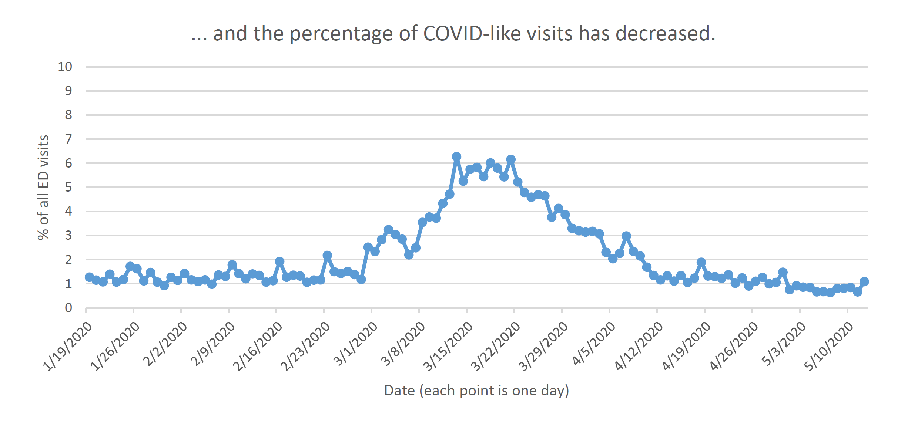
Daily ED visits for CLI

Slide 14
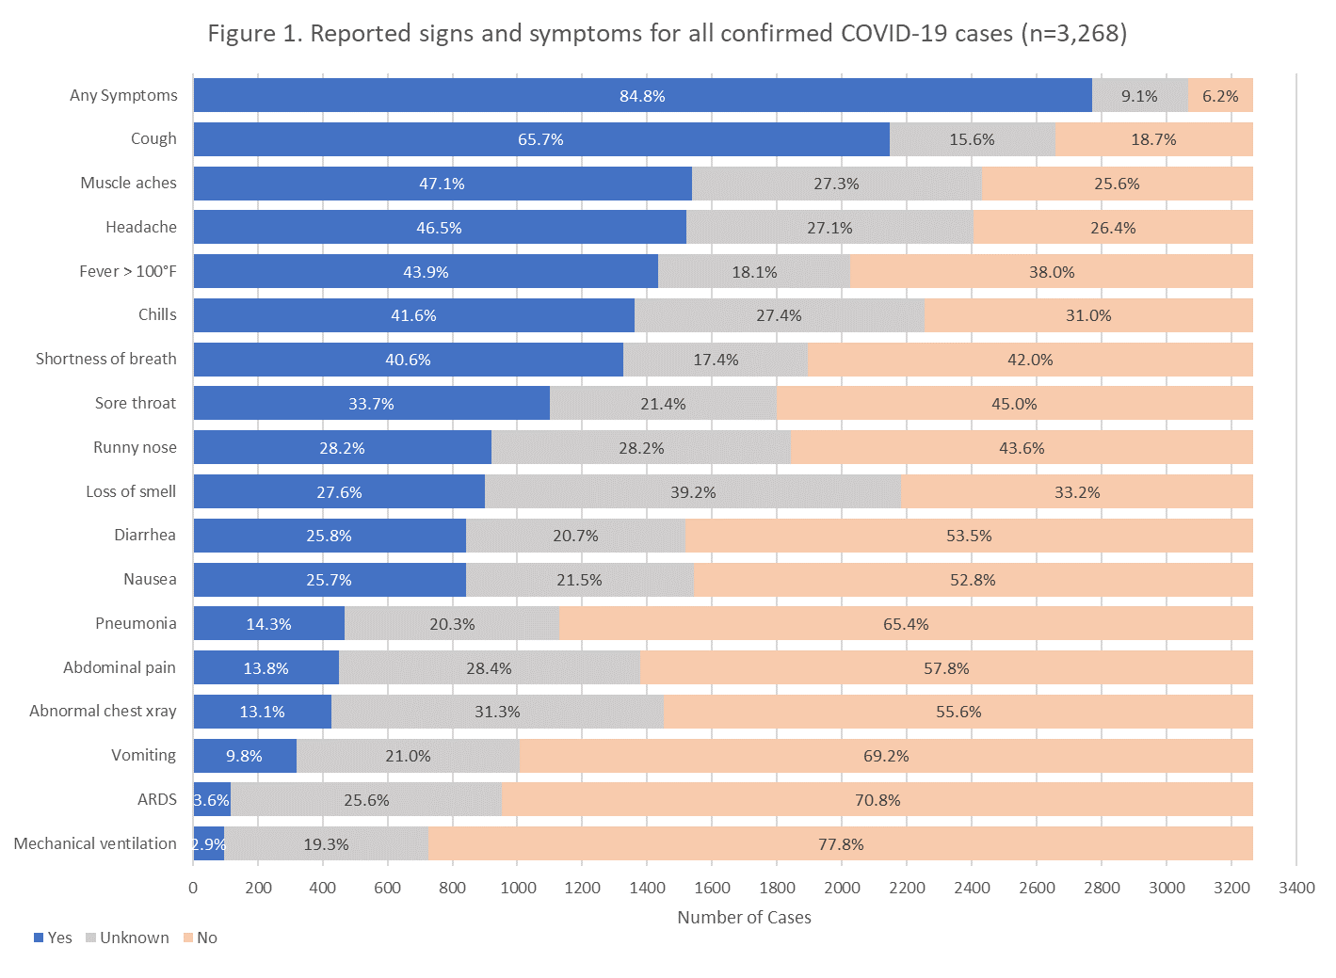
Reported Signs and Symptoms for All
COVID-19 Cases as of May 10 (n=3,268)

Slide 15
Current COVID-19 Hospitalizations
 | Currently Hospitalized COVID-19 Patients* | Currently Hospitalized COVID-19 Positive Patients**
Hospitalized COVID-19 Patients | 163 | 59
COVID-19 Patients in ICU Beds | 38 | 22
COVID-19 Patients on Ventilators | 17 | 12
*Includes both confirmed and suspected COVID-19 patients **Includes only confirmed positive COVID-19 patients
Notes:
Question: According to the table on your slide, among hospitalized 'COVID-19' patients 90 out of 207 are known positives, meaning that 117 either haven't been tested or have tested negative. It's my understanding that testing is now available enough that all suspected cases severe enough to require hospitalization ought to have been tested. If so, then most of those 117 must be false negatives. How does this jive with the reported sensitivities of the lab tests?

Slide 16
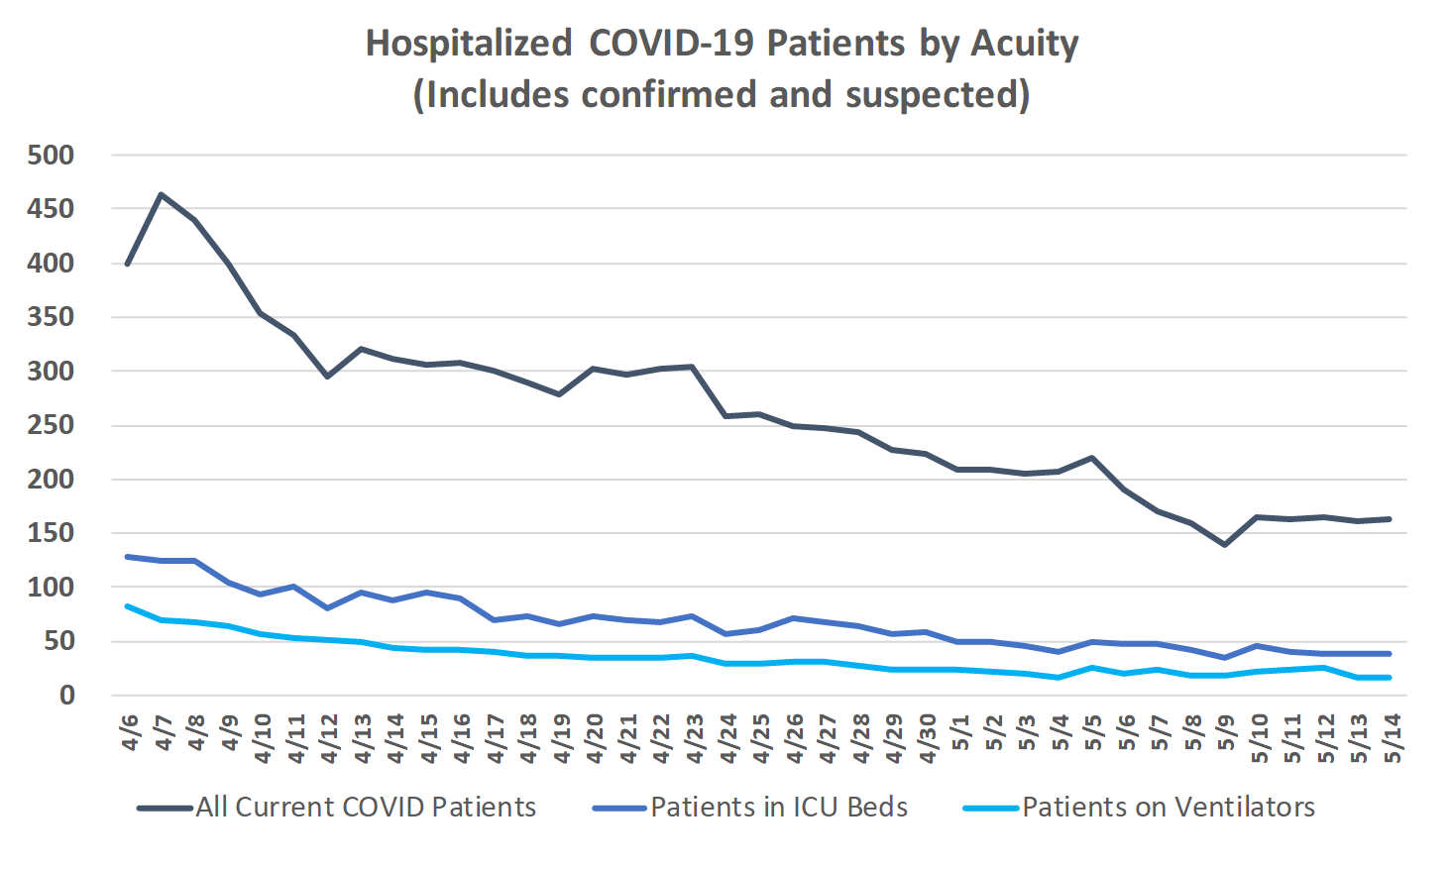
Trends in COVID-19 Hospitalizations

Slide 17
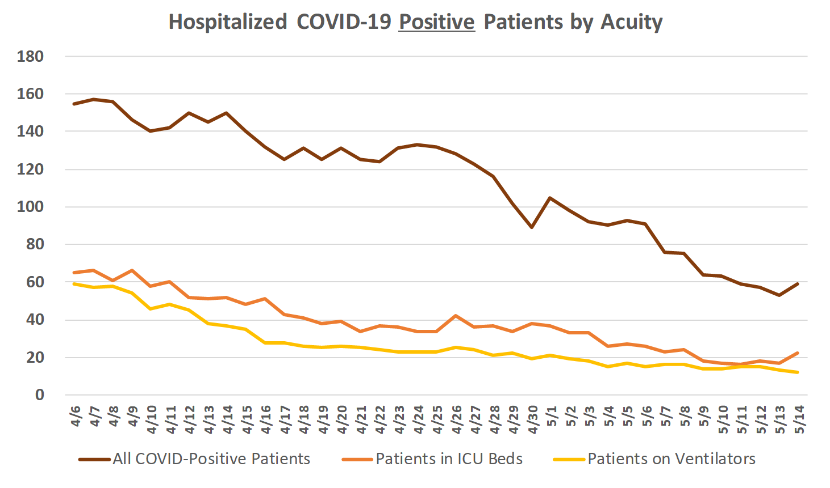
Trends in COVID-19 Hospitalizations

Slide 18
Reopening Oregon

Slide 19
Phased Reopening
Watch Governor Brown’s press conference from today regarding Phase 1 Reopening
Visit Oregon’s Reopening Materials at: www.healthoregon.org/coronavirus
Goals:
  Minimize hospitalizations and deaths
  Allow people to safely return to work so they can support themselves and their families
  Minimize risk to frontline workers
  Avoid overwhelming health systems
  Protect those at highest risk of severe illness, especially communities of color
  Support for small local gatherings that preserve community cohesion and cultural practices.
Notes:
Please understand:
We will be living with the virus until there is reliable treatment or prevention, which is many months off.
The primary tools we have are physical distancing and hygiene.
Every restriction we lift increases transmission and will increase cases.

Slide 20
Reopening Oregon: statewide changes
May 1
  Non-emergency and elective procedures allowed to resume (PPE and hospital capacity dependent)
May 5
  Recreation where physical distancing can be followed (some state park day use areas and boat ramps, option for county/federal campgrounds)
May 15
  Stand-alone retail that was previously closed but can follow OSHA guidelines: furniture stores, art galleries, jewelry shops and boutiques
  Childcare, summer school, camps and youth programs (with limitations and specific guidelines)

Slide 21
Prerequisites for reopening
Declining COVID-19 Prevalence
  Hospitalizations measured by county declining for 14 days
  Emergency department visits for COVID-like illness below influenza-like illness baseline measured statewide
Minimum Testing Regimen
  30 tests per 10K population per week
  Accessible testing for underserved communities
Contact Tracing System
  15 tracers per 100K population
  Able to trace 95% of contacts within 24 hours
  Cultural and linguistic relevant approach

Slide 22
Prerequisites for reopening
Isolation/Quarantine Facilities
  Available room capacity
  Response narratives for group living outbreaks
Finalized Statewide Sector Guidelines
Sufficient Healthcare Capacity
  20% hospital bed surge capacity
Sufficient PPE supply
  Required daily inventory reporting to OHA
  30-day supply required; 14-days for small and rural hospitals
  Sufficient PPE for first responders in the county

Slide 23
Reopening Oregon
Find detailed information about Reopening at www.healthoregon.org/coronavirus including:
Links to county applications for reopening
Data related to reopening criteria for each county/region
Sector guidance documents for reopening
Much more…

Slide 24
Immunizations during
COVID-19

Slide 25
Immunizations during COVID-19 crisis
The CDC’s Morbidity and Mortality Weekly Report (MMWR) released on May 8 outlines the “Effects of the COVID-19 Pandemic on Routine Pediatric Vaccine Ordering and Administration- United States, 2020”
CDC data shows that since the March 13 declaration of a national emergency due to COVID-19:
  Notable decrease in orders for VFC-funded, ACIP-recommended non-influenza childhood vaccines and for measles-containing vaccines
  Similar declines in orders of other vaccines also observed
  Corresponding decline in measles-containing vaccine administrations
The MMWR publication can be found here: https://www.cdc.gov/mmwr/volumes/69/wr/mm6919e2.htm?s_cid=mm6919e2_w

Slide 26
Immunizations during COVID-19 crisis
Based on a survey administered by OHA’s Immunization Program conducted April 18-29th, among clinics that routinely provide immunizations to infants and children:
  95% reported changing their immunization practices
  65% reduced or limited well-child visits, with 5% cancelling all well-child visits
  50% reported cancelling or rescheduling immunizations that were due for older children and adolescents
  81% reported difficulty maintaining staffing
Survey results can be found here: https://www.oregon.gov/oha/PH/PREVENTIONWELLNESS/VACCINESIMMUNIZATION/Documents/Imm-COVIDsurvey.pdf
Notes:
The survey was initiated after OHA officials noticed rapid declines in Oregon VFC vaccine orders; initial drops in weekly immunizations captured by Oregon’s ALERT IIS vaccination database; and reports from health care providers that parents stopped bringing their children in to clinics during the COVID-19 pandemic, and that providers were having difficulty maintaining clinic operations due to financial and staffing issues.

Slide 27
Asymptomatic COVID-19 Transmission

Slide 28
Asymptomatic COVID-19 Transmission
Emerging Infectious Disease (CDC), May 4, 2020
  https://wwwnc.cdc.gov/eid/article/26/7/20-1595_article
Multiple case reports of asymptomatic or presymptomatic transmission
  11 case reports included
  China (9 reports), Germany (1 case), Singapore (7 clusters)
    German and Singapore cases occurred before widespread community transmission
Presymptomatic patients were asymptomatic for 3 to 11 days after known exposure
Virus has been cultured from asymptomatic patients
Models suggest that the speed and extent of SARS-CoV-2 transmission cannot be accounted for solely by transmission from symptomatic persons

Slide 29
Asymptomatic COVID-19 Transmission
The existence of persons with asymptomatic SARS-CoV-2 infection who are capable of transmitting the virus to others has several implications.
  First, the case-fatality rate for COVID-19 may be lower than currently estimated ratios
  Second, transmission while asymptomatic reinforces the value of community interventions to slow the transmission of COVID-19. Knowing that asymptomatic transmission was a possibility, CDC recommended key interventions including physical distancing, use of cloth face coverings in public, and universal masking in healthcare facilities.
  Third, asymptomatic transmission enhances the need to scale up the capacity for widespread testing and thorough contact tracing to detect asymptomatic infections, interrupt undetected transmission chains, and further bend the curve downward.

Slide 30
Pediatric Multisystem Inflammatory Syndrome

Slide 31
Pediatric Multisystem Inflammatory Syndrome
OHA has received its first report of a child with presumed pediatric multi-system inflammatory syndrome associated with COVID-19
  This syndrome was first described in the United Kingdom and has since been reported in the United States
  The symptoms associated with this illness can vary, and can include features similar to Kawasaki disease or toxic shock syndrome
  The syndrome is thought to be a post-infectious response to past SARS-COV-2 infection
  Children typically do not present with respiratory symptoms (e.g., cough, sore throat or congestion)
To date, the most commonly reported signs and symptoms have included:
  Fever >39 degrees C (102.2 F) for several days, hypotension and tachycardia, rash, bilateral conjunctivitis, gastrointestinal symptoms (abdominal pain, vomiting, diarrhea)
  Notably, the SARS-COV-2 PCR test can be negative or positive; serology may be IgG positive.

Slide 32
Pediatric Multisystem Inflammatory Syndrome
OHA distributed a press release on 5/13 which can be found here: https://www.oregon.gov/oha/ERD/Pages/OHA-announces-1st-case-of-COVID-19-linked-pediatric-condition.aspx
A Health Advisory Notice was distributed to Oregon health providers this morning.
OHA is actively working on a case definition and reporting requirements. CDC is expected to release a case definition soon as well.
New York State case definition:
  A child presenting with persistent fever, inflammation (e.g. neutrophilia, elevated C-reactive protein and lymphopenia) and evidence of single or multi-organ dysfunction (shock, cardiac, respiratory, renal, gastrointestinal or neurological disorder).
  Exclusion of any other microbial cause, including bacterial sepsis, staphylococcal or streptococcal shock syndromes, and infections associated with myocarditis such as enterovirus.
.

Slide 33
Pediatric Multisystem Inflammatory Syndrome
Follow-up: Children with unexplained fever and evidence of inflammation (elevated C-reactive protein or white blood cell count) should be carefully followed to detect potential progression of disease.
Laboratory tests: CBC with differential, C-reactive protein, erythrocyte sedimentation rate; D dimer and ferritin; liver function markers; and a cytokine panel. Children should have antibody testing in addition to PCR testing for SARS-CoV-2, since many children are antibody-positive even when PCR-negative.
Echocardiography: Children with this syndrome should have serial echocardiograms including detailed assessment of the coronary arteries. Many to date have been found to have low heart function, and some have enlargement of the coronary arteries. Children with serious cardiac complications should be followed longer-term.

Slide 34
Pediatric Multisystem Inflammatory Syndrome
Treatments have included anticoagulation, IV immunoglobulin, IL-1 or IL-6 blockade, and corticosteroids. Some children have only needed supportive care.
Take home points:
  This is a rare syndrome
  SARS-CoV-2 PCR may be positive or negative
  If a child presents symptoms suggestive of this syndrome, we advise that healthcare providers immediately refer the patient to specialists in pediatric infectious disease, rheumatology, and critical care as clinically indicated. Early diagnosis and treatment are critical.
  We ask that providers report any suspected cases of pediatric multi-system inflammatory syndrome via OHA’s on-line reporting system: www.healthoregon.org/howtoreport, and click on “Online Morbidity Report”
  Reference: Hyperinflammatory shock in children during COVID-19 pandemic, Lancet, May 6, 2020: https://doi.org/10.1016/S0140-6736(20)31094-1

Slide 35
Clinical Care Questions

Slide 36
Answers to Your Questions
What are general return to work guidelines?
  People should be without fever or cough for 72 hours without using fever reducing medicines like aspirin or acetaminophen before returning to work or school. This applies to everyone, not just people that have been tested for COVID-19.
When can health care workers who are positive for COVID-19 by PCR without symptoms return to work?
  Such employees should remain in isolation for 10 days after the positive PCR test before returning to work.
  Same recommendation for asymptomatic COVID+ patients.
What do you recommend for individuals with no medical provider who become ill with Covid-like illness, especially those (with severe symptoms) who need to be referred for in-person urgent care?
  Urgent Care, local ED, 211, OHSU COVID hotline, etc.
Notes:
Are there specific facilities around Oregon that have been designated to see suspected Covid cases with severe symptoms requiring emergency or inpatient care? No.
Is anyone working on guidelines for monitoring at home and when to send to the ED. Historically this has been with signs of respiratory distress, chest pain or change in mentation. There is a lot of talk about monitoring pulse oximetry given the quick decline we can see in some patients, is there any research on changes in pulse oximetry that indicate a poor prognosis?

Slide 37
Closing and Important Contact Info
OHA Coronavirus Information for healthcare providers
http://www.healthoregon.org/coronavirushcp
Email your COVID-19 questions here that you want us to address at future informational sessions (do not expect an individual response and do not send PHI):
HealthCare.Provider@dhsoha.state.or.us

Slide 38
Testing and Transmission of COVID19
Mark K. Slifka, PhD
Professor
Division of Neuroscience
Oregon National Primate Research Center
Oregon Health & Science University
Beaverton, OR 97006
Slifkam@ohsu.edu

Slide 39
Overview
NP RT-PCR tests may have false-negative rates of >30%
  Important that OHA contact tracing strategy includes PCR+ confirmed as well as PCR- presumptive cases
Serology tests are in their infancy – but FDA just released evaluations of their top 12
  Although many tests have a high false-positive rate, some of the latest results look promising
Asymptomatic transmission – what is the evidence to date?
  Comparison of COVID-19 and SARS
Presymptomatic transmission appears 10-fold less efficient than post-symptom onset
  Important for contact tracing , public health perception and upcoming action plans

Slide 40
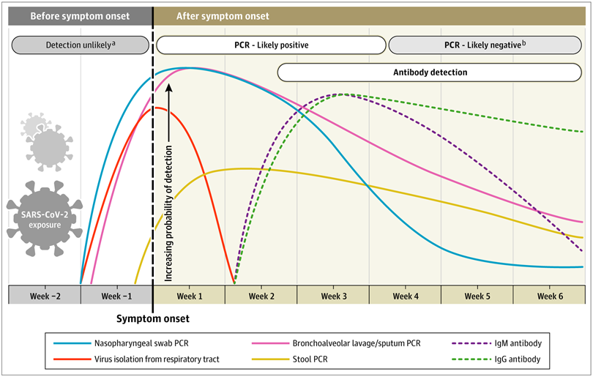
Timeframe for PCR vs. serology testing for COVID-19
Infectious virus is unlikely to be found after the host mounts an antiviral antibody response.
In a study of 9 patients, detection of infectious virus was not observed after Day 8 after symptom onset
R. Wolfel et al., Virological assessment of hospitalized patients with COVID-2019, Nature 2020
That is in part why the “symptom-based strategy” of the Centers for Disease Control and Prevention (CDC) indicates that health care workers can return to work, if “at least 3 days (72 hours) have passed since recovery defined as resolution of fever without the use of fever-reducing medications and improvement in respiratory symptoms (e.g., cough, shortness of breath); and, at least 10 days have passed since symptoms first appeared.”
Nandini Sethuraman et al., Interpreting Diagnostic Tests for SARS-CoV-2. JAMA 2020

Slide 41
No test is perfect: PCR false-negatives, Serology false-positives
Case Report: A COVID-19 pt had 4 sequential pharyngeal swab RT-PCR tests that were negative despite presentation of symptoms including chills, fever and a CT chest scan demonstrating patchy ground-glass opacity upon admission. Case was confirmed by RT-PCR on the 5th day after admission. H. Feng et al., A case report of COVID-19 with false negative RT-PCR test: necessity of chest CT. Jpn J Radiol, (2020)
1,014 COVID-19 cases revealed that chest CT scans have higher sensitivity (88%) than RT-PCR (59%) for diagnosing suspected COVID-19 patients. T. Ai et al., Correlation of Chest CT and RT-PCR Testing in Coronavirus Disease 2019 (COVID-19) in China: A Report of 1014 Cases. Radiology, 200642 (2020)
1,070 samples from 205 COVID-19 cases: BAL fluid (14 of 15; 93%), sputum (72 of 104; 72%), nasal swabs (5 of 8; 63%), pharyngeal swabs (126 of 398; 32%), feces (44 of 153; 29%), blood (3 of 307; 1%), and urine (0/72; 0%) tested positive. W. Wang et al., Detection of SARS-CoV-2 in Different Types of Clinical Specimens. JAMA, (2020) (See also Yang et al. Preprint, next slide)

Slide 42
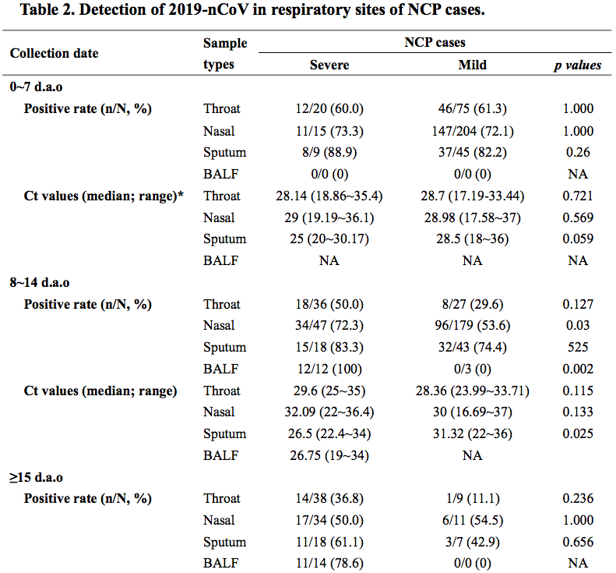
No test is perfect: PCR false-negatives, Serology false-positives
PREPRINT: Yang et al., Evaluating the accuracy of different respiratory specimens in the laboratory diagnosis and monitoring the viral shedding of 2019-nCoV infections. https://www.medrxiv.org/content/10.1101/2020.02.11.20021493v2.full.pdf

Slide 43
No test is perfect: PCR false-negatives, Serology false-positives
General Aspects of Serology:
  Serosurveys can provide seroconversion rates/level of herd immunity
  Antibody responses to RBD & other viral proteins correlate with neutralizing titers
  The protective threshold is unknown and there is no accepted Immune Correlate
  Protection anticipated for 1-3 years, with some protection that may last decades (S. Perlman SARS data)
FDA EUA (Emergency Use Authorization) List with manufacturer’s specifications
Manufacturer Sensitivity Specificity (n) NPV (5% SC) PPV (5% SC) PPV (2% SC)
Cellex 94% 96.0% (250) 99.7% 55% 32%
Autobio 86% 99.4% (312) 99% 83% 64%
Abbot 100% 99.6% (1070) 100% 93% 84%
Roche 100% 99.8% (5272) 100% 97% 91%
EUROIMMUNE 90% 100% (80) 99.5% 100% 100%
https://www.fda.gov/medical-devices/emergency-situations-medical-devices/eua-authorized-serology-test-performance
Excel Calculator for determining PPV: https://www.fda.gov/media/137612/download
% SC = % Seroconversion rate for a particular population
*Quest uses Abbot and EUROIMMUN tests

Slide 44
Who is spreading COVID-19?
Asymptomatics?
Presymptomatics?
Post-symptom onset?
Note: Most people do not transmit COVID-19 efficiently to others
“The distribution of individual R values was highly over-dispersed, with 80% of infections being caused by 8·9% (95% CI 3·5–10·8) of cases…”
Bi et al., Epidemiology and transmission of COVID-19 in 391 cases and 1286 of their close contacts in Shenzhen, China: a retrospective cohort study. Lancet Infect Dis 2020

Slide 45
Asymptomatic spread of COVID-19 or SARS
COVID-19: A study of 24 asymptomatic cases of COVID-19 found that only one asymptomatic carrier transmitted the virus to another person
Hu Z, Song C, Xu C et al. Clinical characteristics of 24 asymptomatic infections with COVID-19 screened among close contacts in Nanjing, China. Sci China Life Sci. 2020
SARS: Of 669 close contacts to symptomatic SARS patients, 101 (15.1%) developed symptoms whereas when 363 others had close contact to SARS patients during the incubation period (i.e. presymptomatic), none (0%) developed symptoms
Zeng G, Xie SY, Li Q, Ou JM. Infectivity of severe acute respiratory syndrome during its incubation period. Biomed Environ Sci. 2009;22(6):502-10
Although several case reports of asymptomatic/presymptomatic spread have been published, these do not provide context in terms of what proportion of transmissions occur by these groups. The data provided here indicates that neither SARS-CoV-2 nor the closely related coronavirus, SARS-CoV, are efficiently spread by asymptomatic carriers

Slide 46
Presymptomatic spread of COVID-19 has raised concerns
“Presymptomatic SARS-CoV-2 Infections and Transmission in a Skilled Nursing Facility”
  NEJM paper in which the outbreak was caused by a worker who came to work on two different days after symptom onset
  Note: “Although we are unable to quantify the contributions of asymptomatic and presymptomatic residents to transmission of SARS-CoV-2 in this facility, evidence suggests that these residents had the potential for substantial viral shedding.” M.M. Aarons et al., NEJM 2020

Slide 47
Presymptomatic spread of COVID-19 has raised concerns
44% Presymptomatic Transmission (note: this is a prediction based on a mathematical model)
X. He et al., Temporal dynamics in viral shedding and transmissibility of COVID-19. Nat Med, (2020).
Based on 77 transmission pairs
Indirect modeling analysis based on secondary sources: Several potential issues with study design, statistics, data interpretation, and mathematical model.
12.6% Presymptomatic Transmission
Z. Du et al., Serial Interval of COVID-19 among Publicly Reported Confirmed Cases. Emerg Infect Dis 26, (2020).
Based on 468 confirmed COVID-19 cases
Indirect analysis of reliable secondary sources: Based on data from 18 Provincial Centers for Disease Control and Prevention
6.4% Presymptomatic Transmission
W. E. Wei et al., Presymptomatic Transmission of SARS-CoV-2 - Singapore, January 23-March 16, 2020. MMWR Morb Mortal Wkly Rep 69, 411-415 (2020).
Based on 157 locally acquired COVID-19 cases
Direct evidence-based contact tracing: shows transmission is 10-fold to 20-fold less efficient prior to disease onset

Slide 48
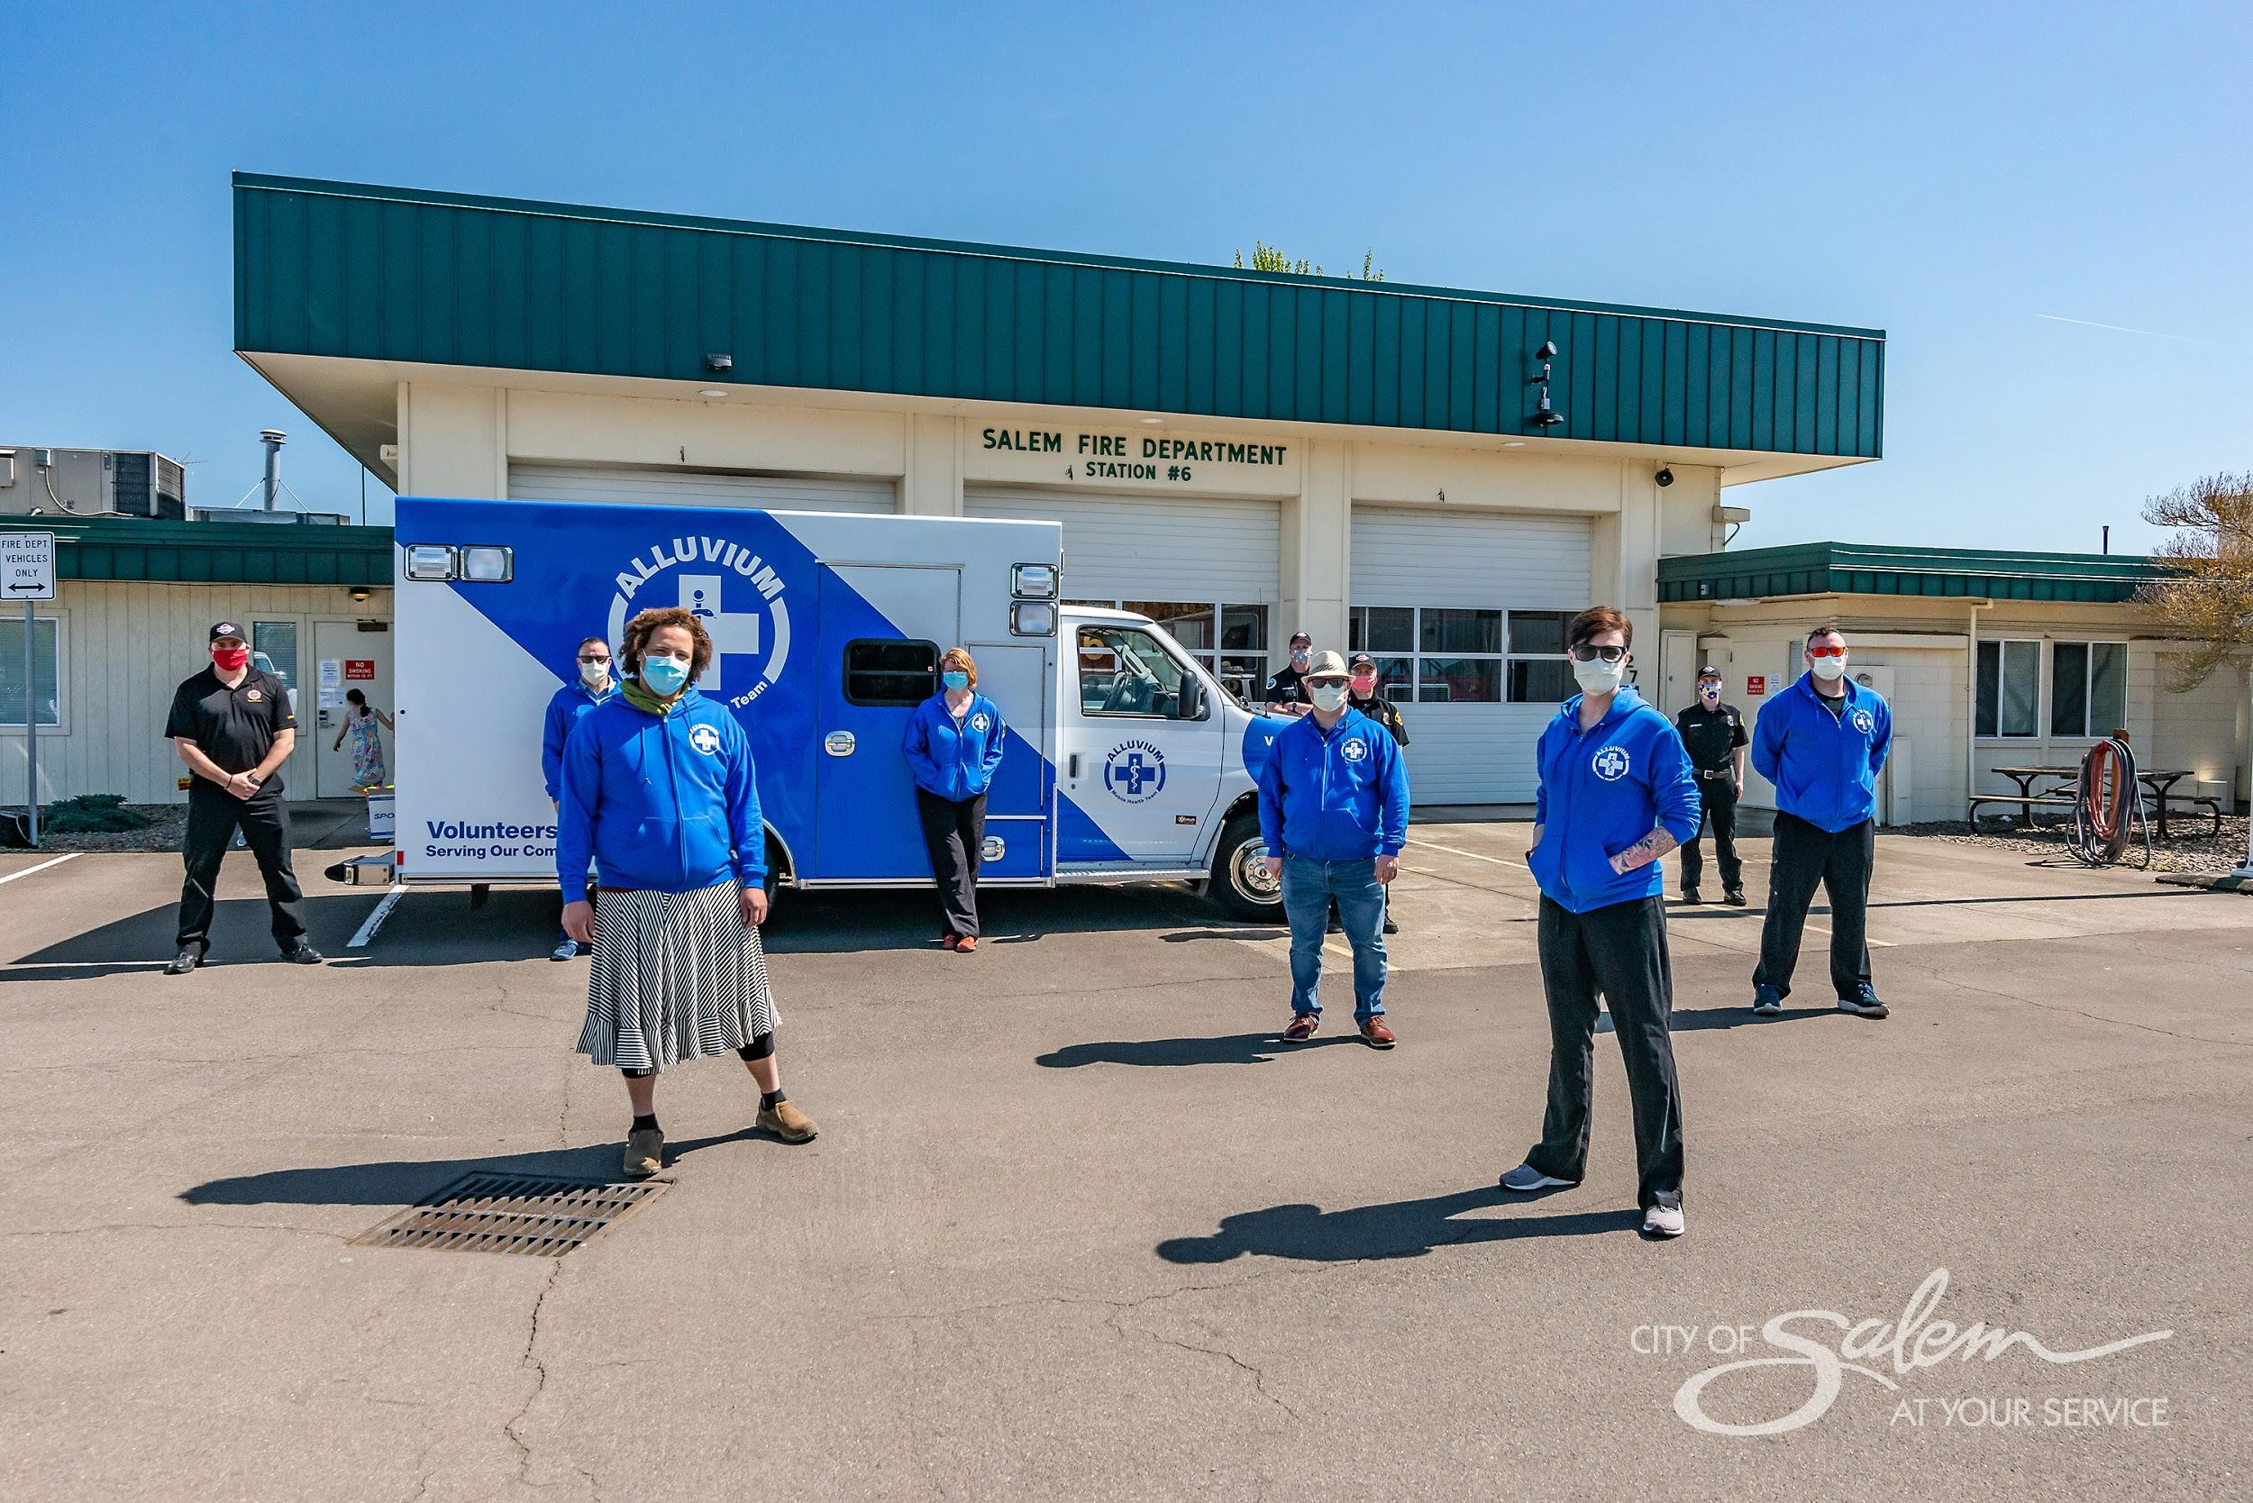
Alluvium Mobile Health Team
Lara Knudsen, MD - lara@alluv.org, 971-599-1002

Slide 49

oregonechonetwork.org

Slide 50
“All Teach, All Learn”
Clinicians learn from specialists
Clinicians learn from each other
Specialists learn from practicing clinicians

